Slide 1
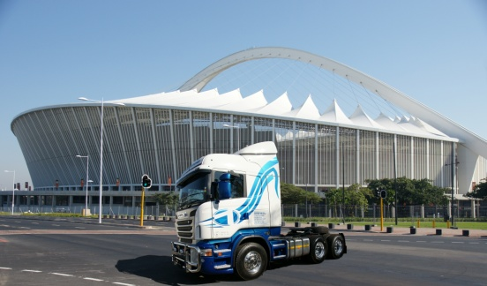
2016
NKOSINATHI FREIGHT (PTY) LTD
TEL: +27 31 903 2192
TEL: +27 31 903 2179
FAX: +27 31 903 2198
CEL: +27 78 804 7093
EMAIL: silsol@iburst.co.za
EMAIL: Info.nkosi@telkomsa.net
7 AARDEN PLACE , AMANZIMTOTI
4126
PO BOX 29163, MAYDON WHARF
4057
PROPOSAL: TRANSPORT AND LOGISTICS

Slide 2
Contents Pages 1. Introduction 3 2. Management and Administration 3 3. Quality Standards 3 4. Goods in transit insurance 4 5. Drivers 4 6. GIT certificate 5 7. Fleet 6-7 8. Policy statement and objectives 8 9. BEE confirmation 8 10. BEE Policy 8 11. BBBE Certificate 9 12. Tax Clearance Certificate 10 13. Road transport rates 11 14. Socio Economic Responsibility 11 15. References 11 16. Standard terms of conditions 12 17. Conclusion 13

Slide 3
1. Introduction It gives us great pleasure in introducing NKOSINATHI FREIGHT (PTY) LTD NKOSINATHI FREIGHT (PTY) LTD is a reputable firm in the transport and logistics industry that has been incorporated since 2014. They specialize in providing transport solutions to a diverse range of clients across South Africa predominantly between Durban and Johannesburg. The company is strategically situated and operates in the transport hub of Durban namely Amanzimtoti and is in close proximity to the Durban Harbour, container terminals, SACD and other cargo handling areas. 2. Management structure The company is owner managed and directed. Operations are executed by a team of highly skilled transport operators. Manager: D SINGH Accounting and administration The entity’s records and administration are maintained by top management. 3. Quality Standards NKOSINATHI FREIGHT (PTY) LTD is committed to quality service and management. It is envisaged that NKOSINATHI FREIGHT (PTY) LTD will remain an efficient, reliable and trustworthy transport partner to its clients yet continuously striving to improve its services.

Slide 4
4. Drivers All drivers are full time employed. All drivers are highly trained and experienced and are aware of the day to day procedures at the terminal and depots. Drivers carrying hazardous cargo have professional driving permits for Hazardous Goods and are trained in their field. We ensure the drivers have valid medical certificates and equipped with relevant “tremcards”. All Drivers are aware of the positioning of containers and are experienced in the “tarping” and strapping of break-bulk cargo 5. Goods in transit insurance All vehicles are covered by goods in transit insurance to the value of R 1 500 000. In certain instances NKOSINATHI FREIGHT (PTY) LTD may outsource transporters; it is company policy to only utilize transporters with valid goods in transit insurance for both local and long distance. As specific insurance for particular items or goods can be arranged it is in the best interest of customers to ensure that their goods are adequately covered. All work is undertaken subject to the Terms of Standard Trading Conditions of NKOSINATHI FREIGHT (PTY) LTD which is available on request. .

Slide 5
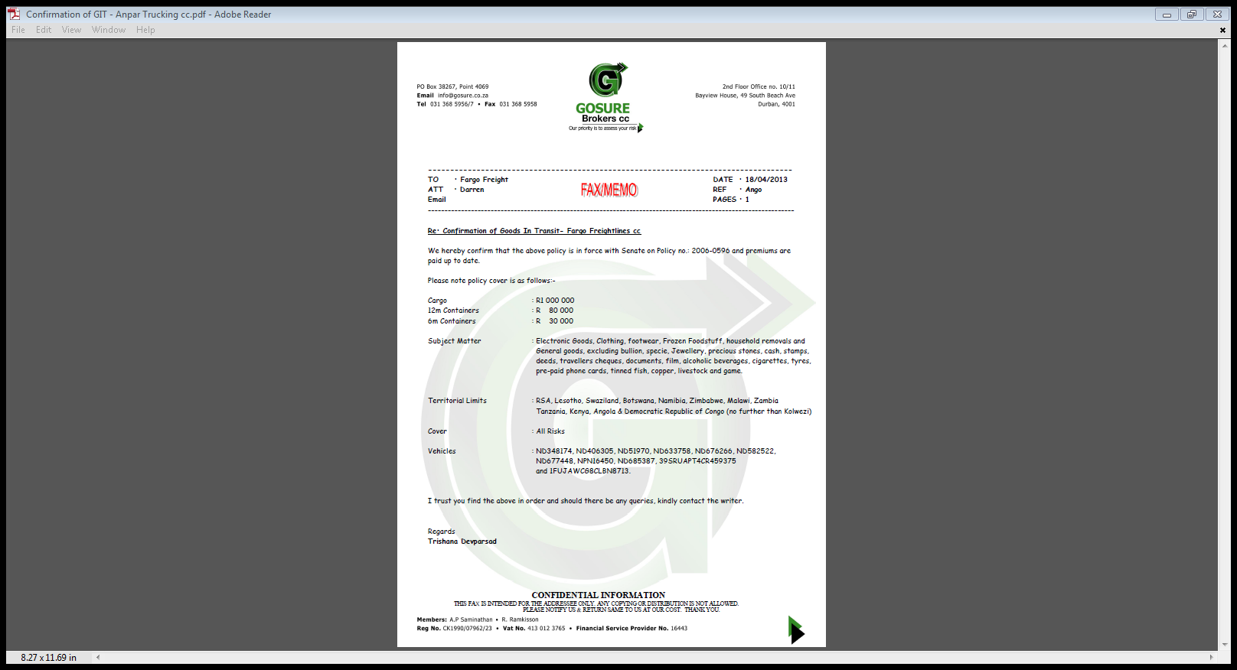

Slide 6
7. Fleet The present fleet consists of numerous freightliner mechanical horse and trailers, Scanias and International. Presently the company uses the services of various dependable and trust worthy sub contractors. Should the need arise the company has long standing relationships with a list of reputable and reliable transport coordinators to meet any demand that may present itself. The company has the experience and has handled cargoes of all proportion, ranging from the normal container cargoes to the abnormal cargoes, hazardous and specialized cargo. The entity is a bonded carrier. Over-border transport is also arranged when specially requested. All local and long distance vehicles are equipped with strapping equipment, tarpaulins and twist locks, chains and lashing equipment are provided for abnormal cargo. In addition we are fully equipped to carry reefer containers as our trailers are fitted with our own gensets Vehicles carrying hazardous cargo are equipped with haz-chem permits. For the convenience in communication we ensure all drivers are equipped with mobile phones and two way radio communication. Company vehicles and those of our sub contractors are installed with tracker devices for the recovery of cargo and vehicles in the event of hijack occurrences.

Slide 7
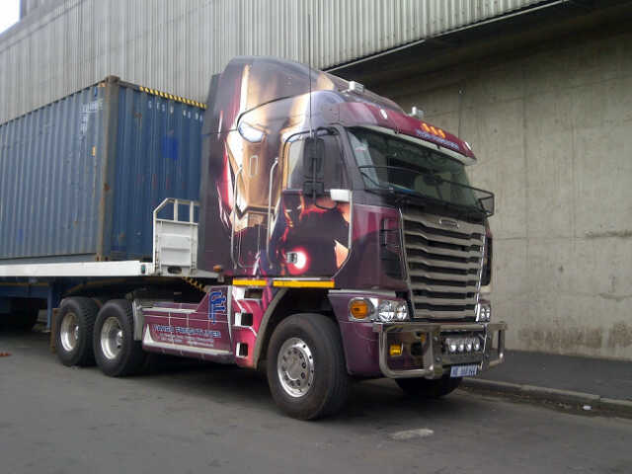
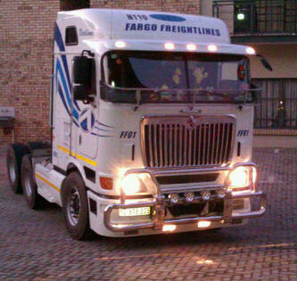
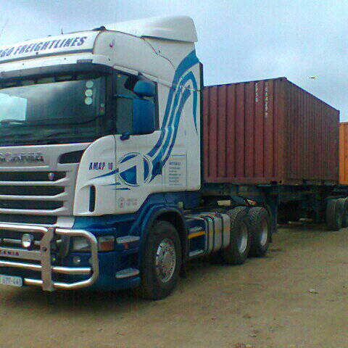
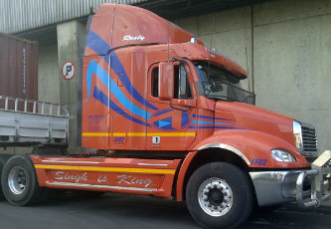

Slide 8
8. Policy statement and objectives The quality policy of NKOSINATHI FREIGHT (PTY) LTD is to maintain and enhance its market position as a well-established and effective transport agency. This shall be achieved by providing customers with the range of transport services controlled by a Quality Management System. 9. BEE Confirmation NKOSINATHI FREIGHT (PTY) LTD was incorporated as a PRIVATE COMPANY on the 17th September 2014. The manger is Mr Darren Singh. The manager is classified as black in terms of the country’s BEE policy making the company 100% black owned. Management of NKOSINATHI FREIGHT (PTY) LTD is also 100% black. NKOSINATHI FREIGHT (PTY) LTD In terms of South African BEE Policy and Framework Requirements, qualifies for 125% B-BBE Status and is a level one contributor. 10. BEE Policy The company conforms to the South African BEE Policy and Framework Requirements and supports BEE Companies in terms of its supplier of services and SMME companies 11. Compliance NKOSINATHI FREIGHT (PTY) LTD commits itself to complying with South African laws and regulations, ensuring they meet requirements of South African Revenue Services (SARS)

Slide 9
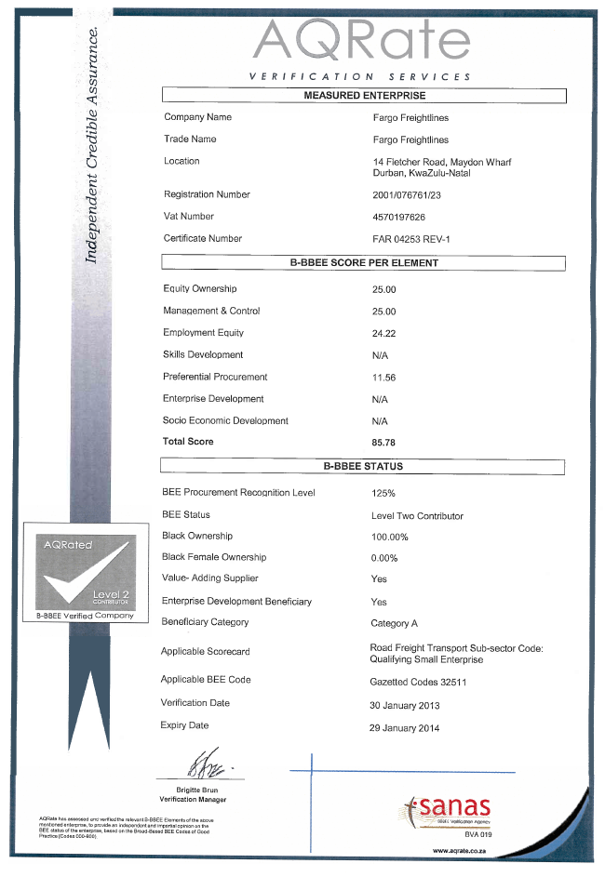

Slide 10
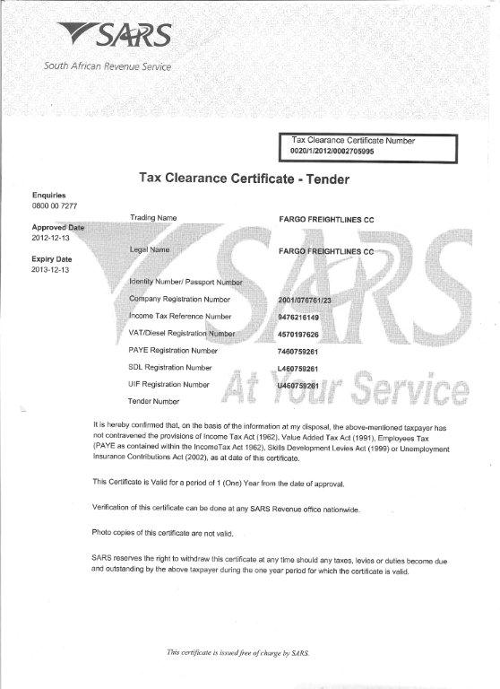

Slide 11
13. Road transportation rates
Our rates are customised to suit your needs. Rates will gladly be provided on request.
14. Socio Economic Development
NKOSINATHI FREIGHT (PTY) LTD is completely aware of and committed to its corporate social economic responsibility to the public.
15. References
Suppliers and Customer information will be provided on request .

Slide 12
16. Standard Terms of Conditions This document submitted by NKOSINATHI FREIGHT (PTY) LTD are for the use only of the client concerned and are not to be reproduced or disclosed to third parties without prior consent confirmed in writing by the member of NKOSINATHI FREIGHT (PTY) LTD An estimate of ’NKOSINATHI FREIGHT (PTY) LTD charges and expenses are provided in the attached proposal. This remains valid for the period stated in the proposal or for ninety days from the date of submission. NKOSINATHI FREIGHT (PTY) LTD reserves the right at any time prior to completion of the proposal to adjust the price to take account of any increase in the cost of sales, labour services or other overheads. Any change affecting the proposed estimate will be subject to three months' notice in writing. NKOSINATHI FREIGHT (PTY) LTD will not be liable to the client for any loss or claim which is not reasonably foreseeable on acceptance of the proposal. NKOSINATHI FREIGHT (PTY) LTD shall not be liable for any consequential or indirect loss suffered by the client whether this loss arises from a breach of duty in contract or tort or in any other way (including loss arising from ’ NKOSINATHI FREIGHT (PTY) LTD s negligence). It is a condition of acceptance of the attached proposal and of any contract arising there from that the client will not, either during the execution of this project or for a period of one year from the completion thereof, recruit or employ either directly or indirectly either full-time or part-time any person who is employed by NKOSINATHI FREIGHT (PTY) LTD upon or in connection with the execution of this Project without NKOSINATHI FREIGHT (PTY) LTD’s prior consent in writing. Work done or services undertaken are subject to the above Terms and Conditions and all other conditions warranties and representations, expressed or implied, are hereby excluded unless confirmed in writing by the Member of NKOSINATHI FREIGHT (PTY) LTD .

Slide 13
17. Conclusion I thank you for affording us the opportunity of introducing our company to you. Should you require any further information or wish to discuss any matters in this proposal, do not hesitate to contact me. Assuring you off our personal attention at all times.

